Slide 1
Multidimensional scaling
Pimonrat Tiansawat

Slide 2
Students should be able
To described some terms related to NMDS
To explain step to do NMDS

Slide 3
Multidimensional scaling (MDS)
Visualize the level of similarity (or dissimilarity) of individual cases
Abundance of species A
0
5
10
15
Plot 1
5
Plot 3
7
Plot 2
15

Slide 4
Goal of MDS
Reconstruct a map that preserves distances
Several types of MDS
Classical MDS: Principal Coordinate Analysis
Metric MDS
Non-metric MDS: NMDS

Slide 5
NMDS
Plot sp1 sp2 sp3 sp4 sp5 sp6 sp7 sp8…
1 1 0 0 0 0 0 0
2 3 0 0 2 0 3 4
3 0 4 0 7 0 2 0
4 0 8 0 2 0 2 3
5 2 0 0 0 4 2 2
6 2 0 0 0 3 0 0

Slide 6
NMDS procedure
Calculate distance matrix → rank
Specify the number of reduced dimensions (common = 2)
Construct the configuration of samples in N dimension (coordinate)
Regress distance in the map against the observed data
Determine stress and decide if it needs to reconstruct the configuration
Repeat step 5 until stress is minimum

Slide 7
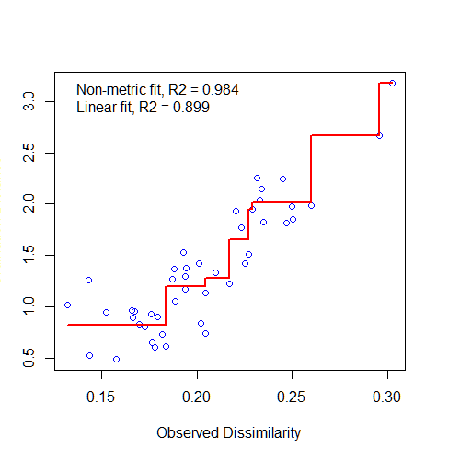
Shepard plot
Ordination
distance
https://jslefche.files.wordpress.com/2012/10/stressplot.png
Notes:
http://ecopy.readthedocs.io/en/latest/_images/duneshepard.png

Slide 8
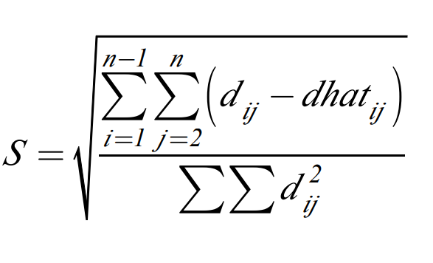
Stress – goodness of fit
Observed
dissimilarity
Ordination
distance
Low stress is better.
>0.3 is poor
0.2 is ok
0.1 is great
< 0.05 is excellent

Slide 9
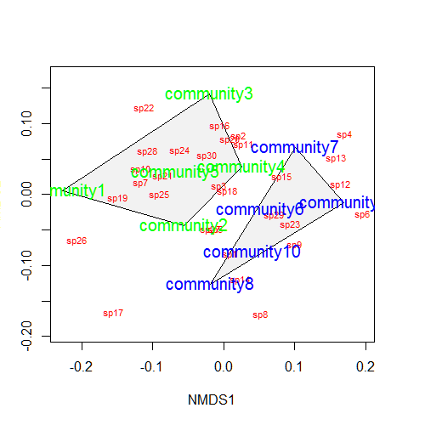
https://jslefche.files.wordpress.com/2012/10/nmdsconvex.png

